Slide 1

Stacks and queues analysis of abstract data structures
CST-201 Warren Peterson & Gregory duffley
STACKS
QUEUES
Notes:
Slide Created by Warren Peterson & Gregory Duffley on 12/4/2021

Slide 2

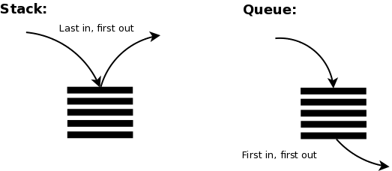
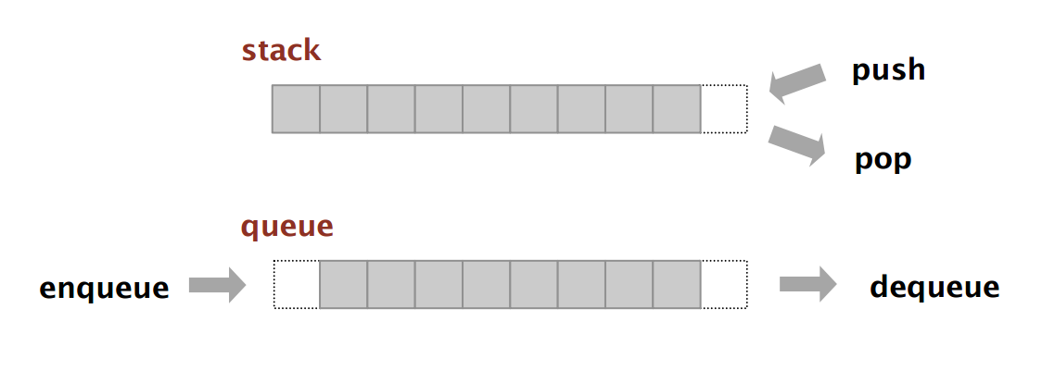


QUEUES:
1.) First-in First-out (FIFO) collections.
2.) Enqueuing is adding to the back of the queue.
3.) Dequeuing is removing from the front of the queue.
A queue is like a line at the movie theatre. Different ends are used to enqueue(insert) and dequeue(remove) elements.
Suppose q is an empty line
q.deq() → “John”
“Zack”
“Sara”
q.enq(“John”);
q.deq() → “Sara”
“John”
q.enq(“Sara”);
“Zack”
q.deq() → “Zack”
“Sara”
“John”
q.enq(“Zack”);
“Zack”
“Sara”
“John”
Notes:
Slide Created by Warren Peterson on 12/4/2021

Slide 3
QUEUE Interface
Import java.util.*; imports Iterator and Iterable
/**Interface to mutable queues with elements of type T.
A queue is a first-in-first-out collection.*/
public interface Queue<T> extends Iterable<T> {
public void enq(T elt); // Add elt to back of queue
public T deq(); // Remove and return element from front of queue, Throw RuntimeException if is empty.
public T front(); // Return front element of queue without removing it
// Throw RuntimeException if queue is empty.
public Boolean isEmpty(); // Return true if this queue is empty; else false
public int size(); // Return the number of elements in this queue.
public void clear(); // Remove all elements from this queue.
public Queue<T> copy(); // Return a shallow copy of this queue.
public Iterator<T> iterator(); // Return an iterator that yields this queue’s elements from front to back.
}
Notes:
Slide Created by Warren Peterson on 12/4/2021

Slide 4
Time Complexity of queue functions
public T dequeue() { // Time Complexity is Constant Time O(1)
if (isEmpty()) {
throw new RuntimeException(“Trying to deque() an empty queue”);
} else {
size--;
return front.value;
}
}
public void enqueue(T v) { // Time Complexity is Constant Time O(1)
if (isEmpty) {
front = new ListNode<T>(v, null);
throw new RuntimeException(“Trying to enqueue() an empty queue”);
} else {
back.next = new ListNode<T>(v, null);
back = back.next;
}
size++;
}
public T front(){} // O(1)
public int size(){} // O(1)
public Boolean isEmpty(){} //O(1)
Public void clear(){} //O(1)
Notes:
Slide Created by Warren Peterson on 12/4/2021 Complexity of almost all Queue methods are constant Time
Queue<T> copy() is Linear Time
toString() is also Linear Time

Slide 5
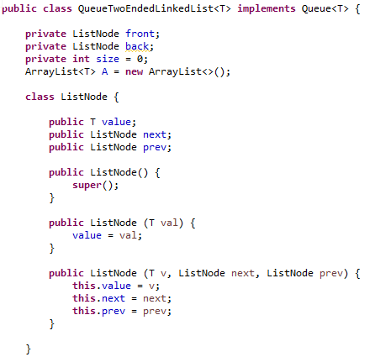
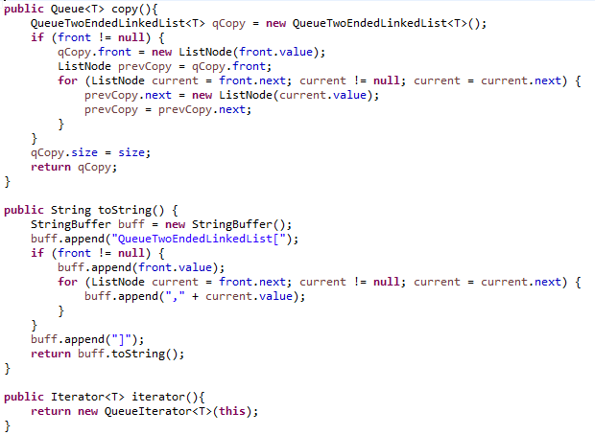
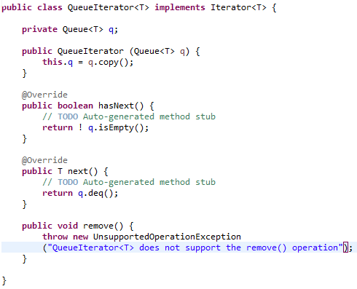
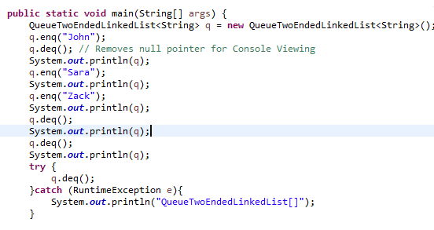
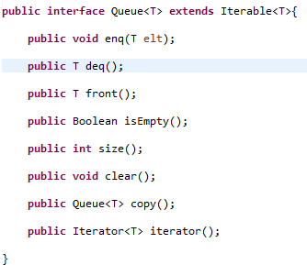
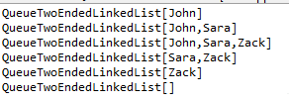
Implementing a Queue abstract data type
Notes:
Slide Created by Warren Peterson on 12/4/2021
Shows some of the classes in the implementation of a Queue where it adds three people to the line and then removes the front person three times until the line is empty

Slide 6
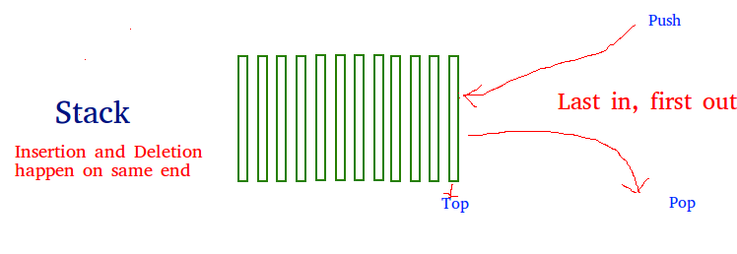
Stack Data Structure
Notes:
Slide Created by Gregory Duffley on 12/5/2021

Slide 7
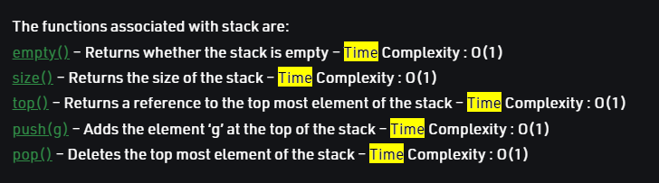
TIME COMPLEXITY OF STACK FUNCTIONS
Notes:
Slide Created by Gregory Duffley on 12/5/2021

Slide 8
Stack Data Structure
#include <iostream>
#include <stack>
using namespace std;
int main() {
stack<int> stack;
stack.push(21);
stack.push(22);
stack.push(24);
stack.push(25);
stack.pop();
stack.pop();
while (!stack.empty()) {
cout << ' ' << stack.top();
stack.pop();
}
}
Notes:
Slide Created by Gregory Duffley on 12/5/2021

